Slide 1
Deep Learning-Based Gender Detection and Multi-Class Image Classification Using CNN Architectures
Project Presented by team- code crusaders
Team members-
Roham Maiti and Suparna Biswas- sister Nivedita university, kolkata

Slide 2
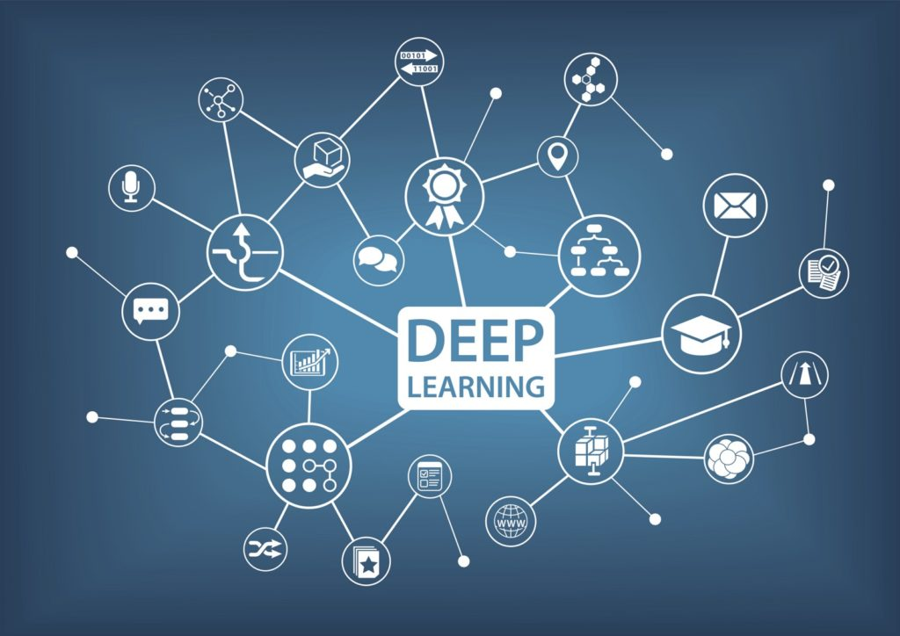
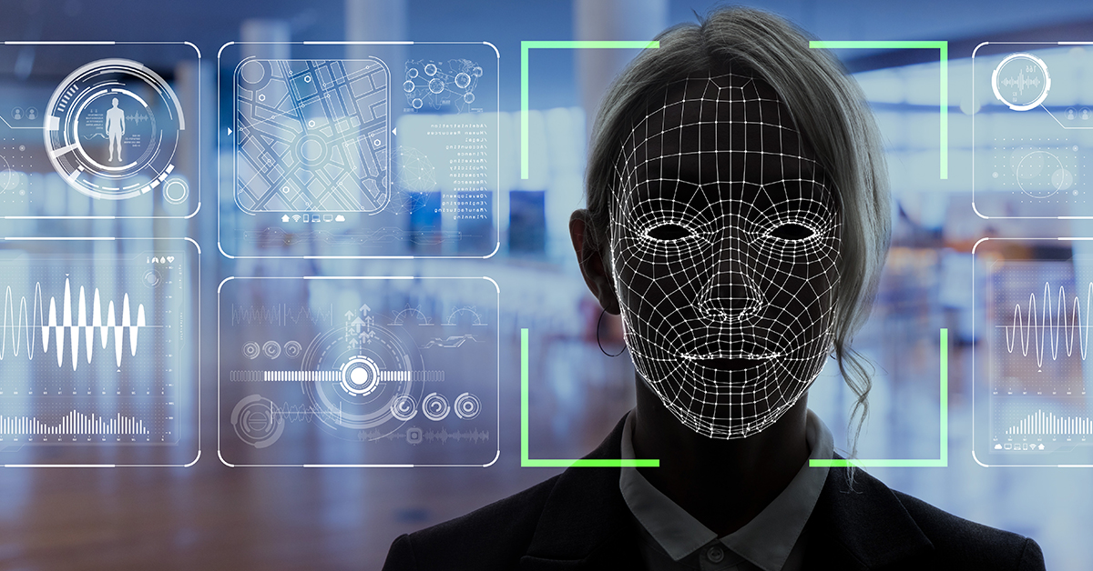
Contents
Abstract
Introduction
Problem Statement
Methodology
Results
Conclusion
Future Works

Slide 3
Introduction
Gender classification and face detection are fundamental tasks in computer vision that focus on analyzing and interpreting facial features. Gender classification aims to automatically determine whether a detected face belongs to a male or female by learning distinguishing patterns from facial images. Face detection serves as a crucial preliminary step, locating and isolating faces within an image to enable further analysis. Together, these tasks form the foundation for various real-world applications, including identity verification, demographic analysis, and human-computer interaction, where accurate and efficient recognition of facial attributes is essential.

Slide 4
Problem statement
Although there are many face detection and recognition algorithms such as using CNN based detectors, HOG or algorithms like Haar cascades, FaceNet, DeepFace etc. these models require huge amount of data for training and takes too much time to get trained. Furthermore, in real world scenario it is often observed that the se models sometimes perform poorly. The reasons for this are attributed to factors such as covered faces, changes in light settings, harsh weather conditions etc. These adverse conditions reduces the ability of these models to perform well in real world scenario where environmental conditions play a big factor in face recognition. As a result, there is a growing need to develop more robust, efficient, and adaptable face detection and recognition systems that can handle such challenges. This has led to increased interest in hybrid models, data augmentation techniques, and the integration of additional sensor data (such as infrared or depth sensors) to improve accuracy and reliability across diverse environments.
Our proposed solution that we will come up with, will try to address these challenges to make an efficient face recognition system that will try to perform well in all types of scenario.

Slide 5
dataset
For or project, we have FACECOM Dataset. The dataset is divided into two portions namely- Task A and Task B. Task A is for gender classification of a person present in the image as male or female. Task B corresponds to face recognition of various personalities that are present in the dataset.
For Task A, there are 1926 training and 422 validation image as our data divided into two classes, male and female.
For Task B, there are 15,408 training and 3376 validation image as our data with 877 unique identities in training and 250 unique identities in validation set.

Slide 6
Methodology
For our research in this topic, there are 2 tasks namely-
Gender Classification- To detect gender of the person that is shown in the image i.e. male or female.
Face Recognition- To recognize faces of various people under adverse conditions like low light, bright light, rain etc.
For our first task, we have chosen DenseNet-169 model which is a very efficient model used for image classification.
For our second task we have used Siamese network and combined it with DenseNet- 121model for increasing efficiency of image recognition.

Slide 7
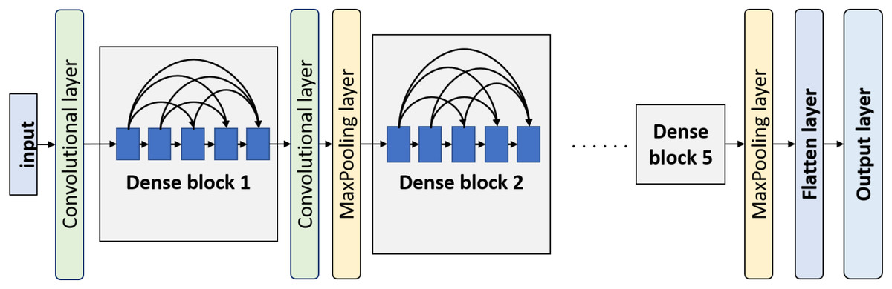
Task- A methodology
The task starts with pre processing of images into train and test sets properly. This includes resizing all the images into a fixed shape of 224x224, this is followed by normalization of pixel values between 0 and 1. As the dataset s highly imbalanced and biased towards Male class more, we used data augmentation to Female class using rotation, horizontal flip, zoom etc.
For this task, we used DenseNET- 169 which was pre-trained on ImageNet, a dataset of containing nearly 1 million images. We used fully connected layer with sigmoid activation as it’s classifier head. The model was trained for 50 epochs with Adam optimizer, Binary Cross entropy as loss function.
The DenseNET architecture works by connecting each layer to every layer in a feed forward fashion. This differs from traditional CNN models which have connections between consecutive layers. The dense connectivity promotes feature reuse, reduces parameters for training and alleviates vanishing gradient problem.
Then we obtain the results such as accuracy, precision, f1 score, confusion matrix, etc.

Slide 8
Task- b methodology
For this task, we have chosen a combination of Siamese Network, DenseNet-121, and cosine similarity for accurate face recognition. We resize the images into a fixed shape of 224×224, then decode the images into tensors. We normalize the pixel values between 0 and 1.
We define a generator function that creates batches of image pairs, with each batch containing half positive pairs (same identity) and half negative pairs (different identities). For positive pairs, we assign the label as 1, and for negative pairs, the label is set to 0.
Next, we build a Siamese model that takes two input images and outputs a similarity score between 0 and 1. We use DenseNet-121 pretrained on ImageNet as the feature extractor and freeze its layers to retain the learned representations. The extracted features from both input images are passed through a dense layer to produce 128-dimensional embeddings, which are then normalized to unit vectors
Cosine similarity is computed between the two embeddings using a Dot layer with normalization enabled, and a sigmoid activation is applied to produce the final output score. The model is compiled using the Adam optimizer with a binary cross-entropy loss function and trained using the custom generator. We also incorporate callbacks like ModelCheckpoint and ReduceLROnPlateau to save the best model and adjust the learning rate during training.
This architecture allows the model to effectively learn a similarity metric, enabling it to distinguish between faces of the same and different identities with high accuracy. We have trained this model for 15 epochs.

Slide 9
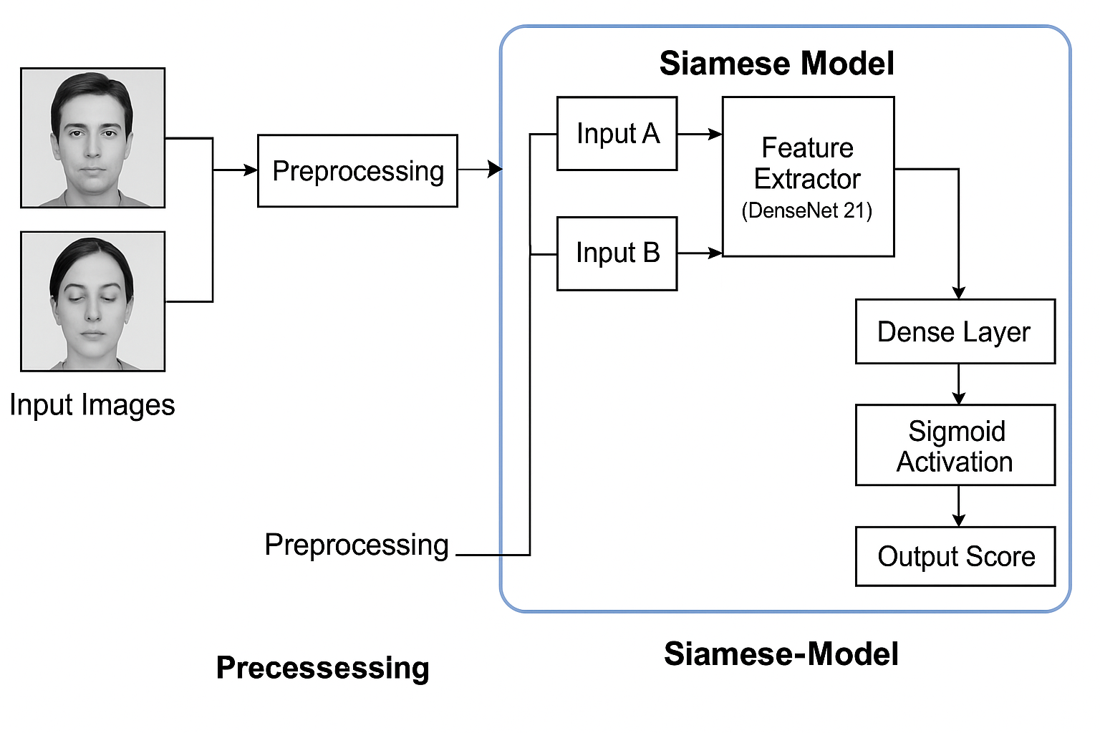
Task b workflow

Slide 10
Results
In this section, we will discuss about the results that we achieved in both the tasks. The results are evaluated on the validation set that was provided. Here we will discuss about the various aspects of results obtained such as Top-1 Accuracy, Macro Precision, Macro Recall and Macro F1 score in task B and confusion matrix, accuracy, precision, f1 score, recall in Task A. For task A, we have obtained highest accuracy of 92% and lowest accuracy of 91%. For task B, we have got Top-1 Accuracy of 92.59%. We will discuss in details about the results in coming slides.

Slide 11
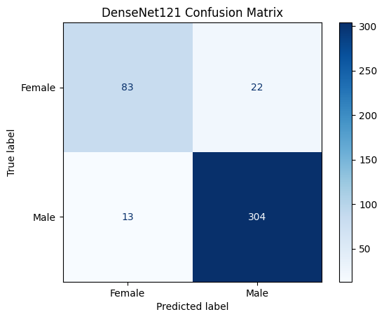
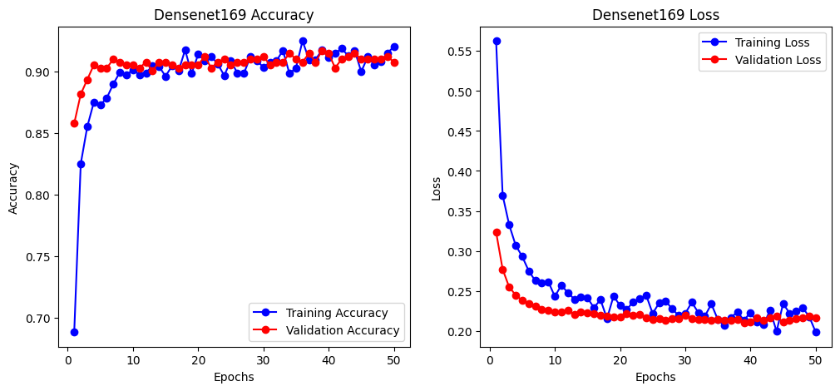
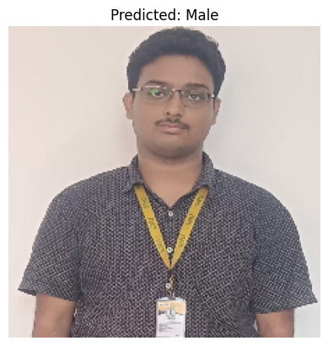
Task A results

Slide 12
Task a results
There are 422 images in validation set out of which 105 are female and 317 are male. Out of 105 females 83 are predicted correctly. Out of 317 males, 304 males are predicted correctly.
Overall accuracy is nearly 92%
For male, the precision was 93% and for female it was 86%.
For male, the recall was 96% and for female it was 79%.
For male, the f1 score was 95% and for female it was 83%.

Slide 13
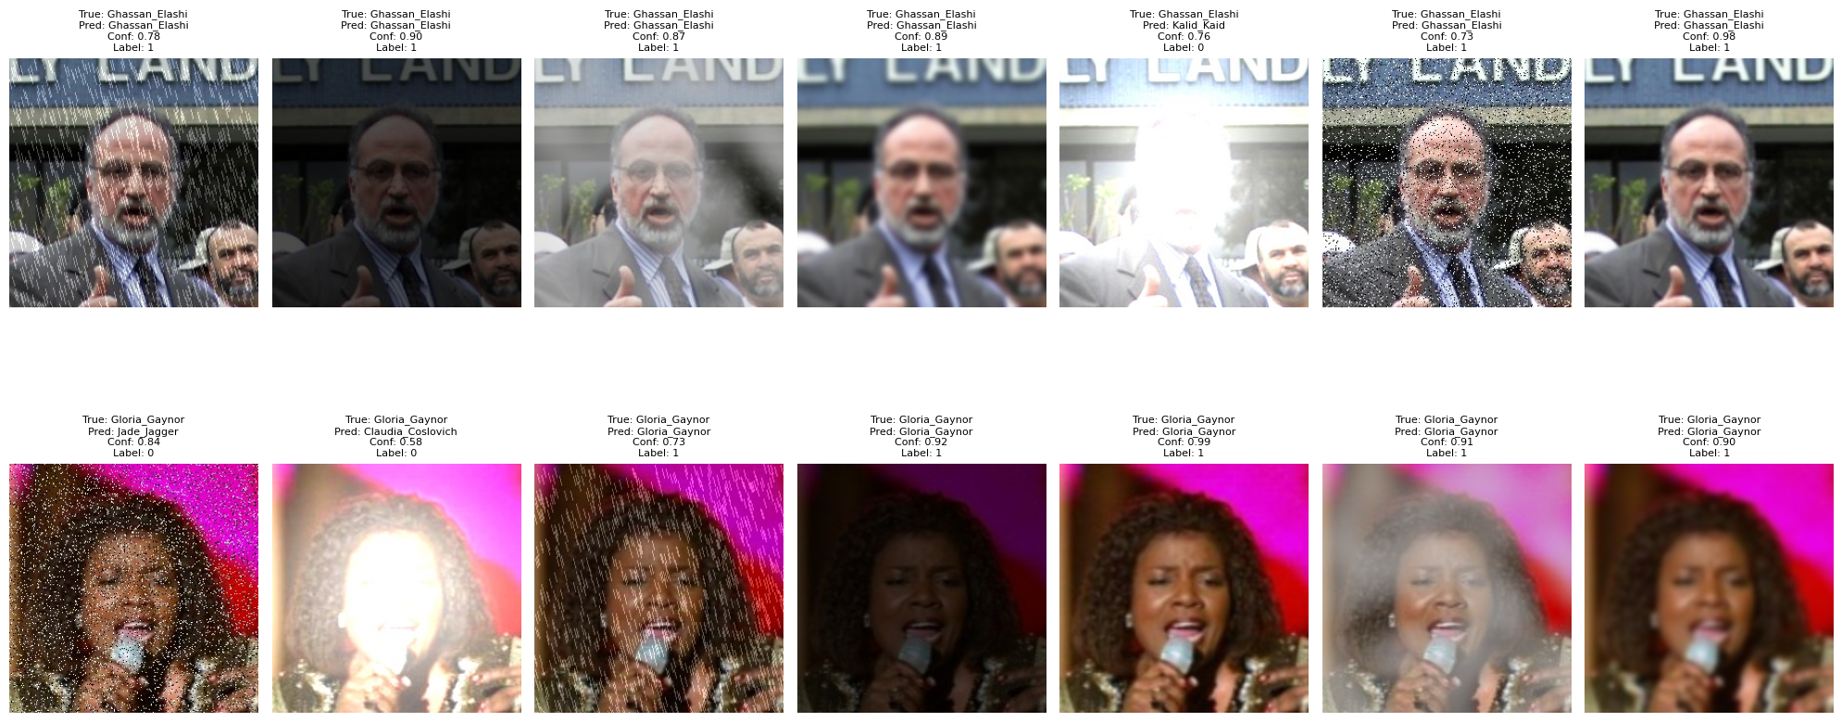
Task B Result

Slide 14
Task B Result
The main output of Task B is to see weather the model can correctly identify an individual under harsh environment conditions such as low light, bright light, rainy conditions etc.
The Top-1 Accuracy is 94.65% .
Macro Precision- 100% .
Macro Recall- 94.65% .
Macro F1 Score- 97.25% .

Slide 15
Conclusion
We successfully created and assessed two deep learning systems in this project that were aimed at solving actual facial analysis issues. High-performing CNN architectures were used for binary gender classification in Task A; DenseNet169 was selected in the end due to its exceptional accuracy and resilience. Using a Siamese Network architecture, Task B addressed the more difficult problem of face matching under distortions, effectively verifying identity by utilizing cosine similarity and DenseNET-based embeddings. Both systems performed well and fit in nicely with the competition's goals because they were designed with scalability, modularity, and evaluation rigor in mind.

Slide 16
Future Work
In future, we can explore out other options to recognize faces under extreme conditions. This may include models which maybe easier to implement or any other methods in which we can use any image processing techniques which is predicted to be more efficient, fast and resource friendly.
We can also combine both the models to recognize the person alongside it’s gender.

